Slide 1
Gandhiji the voice of millions

Slide 2
‘My hesitancy in speech, which was once an annoyance, is now a pleasure. Its greatest benefit has been that it has taught me the economy of words’
Gandhiji

Slide 3
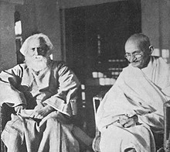
Mahatma Gandhi is a call to the nation in today’s time when we’re surrounded by atrocities every time we turn on the news channel. Mahatma Gandhi’s simple living, high thinking reflected in the simplicity and profoundness of his words. Without raising so much so as a finger, Gandhiji stirred the soul of the nation with his powerful words in a gentle voice, uniting Indians across castes and creeds towards the common vision of a Free India.

Slide 4
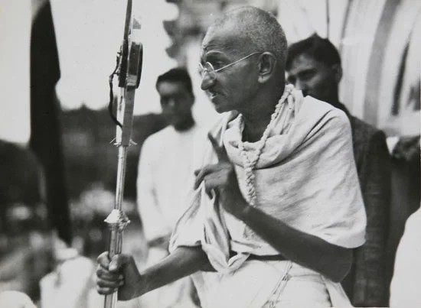
Mahatma Gandhi was one of the greatest national and civil rights leaders of the 20th century. He served as a lawyer, politician, and activist in the struggle for social justice and for India’s independence from British rule. Gandhi is internationally esteemed for his doctrine of nonviolent protest (satyagraha) to achieve political and social progress

Slide 5
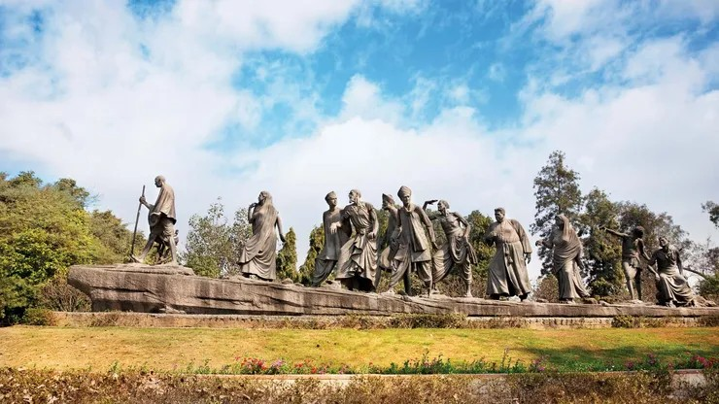

Slide 6
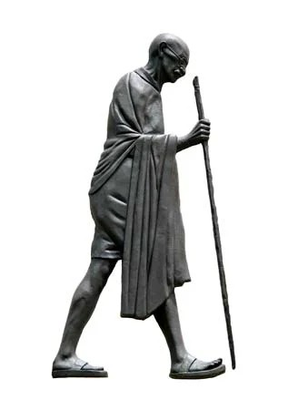
By the autumn of 1920, Gandhi was the dominant figure on the political stage, commanding an influence never before attained by any political leader in India or perhaps in any other country. He refashioned the 35-year-old Indian National Congress (Congress Party) into an effective political instrument of Indian nationalism: from a three-day Christmas-week picnic of the upper middle class in one of the principal cities of India, it became a mass organization with its roots in small towns and villages. Gandhi’s message was simple: it was not British guns but imperfections of Indians themselves that kept their country in bondage

Slide 7
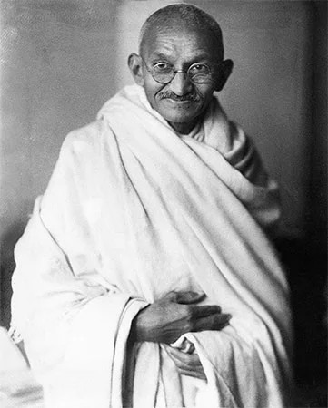
It was inevitable that Gandhi’s role as a political leader should loom larger in the public imagination, but the mainspring of his life lay in religion, not in politics. And religion for him did not mean formalism, dogma, ritual, or sectarianism. “What I have been striving and pining to achieve these thirty years,” he wrote in his autobiography, “is to see God face to face.

Slide 8
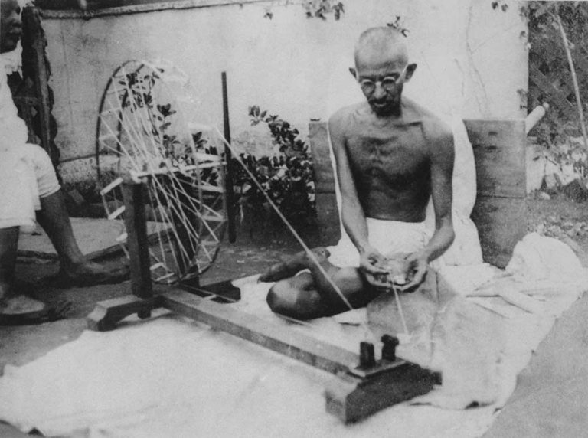
Mahatma Gandhi is revered in India as the father of the country. He is remembered most for his nonviolent means of working for social justice, his acceptance of all faiths, and his ability to bring conflicting groups together. The model of satyagraha has inspired civil rights leaders, such as Martin Luther King, Jr., in many nations. Today Gandhi is one of the most universally known and revered figures in the world.

Slide 9
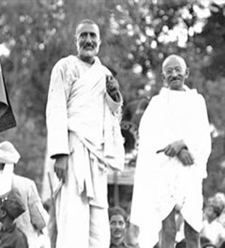
As a firm believer and practitioner of Ahimsa and Shanthi, Gandhi not just preached these ideals, he walked with his lathi and followers for support. He firmly believed that his words and actions that aligned with his intent had the power to change the world and the rest is history.

Slide 10
Gandhi’s advocacy of non-violence is closely connected to his attitude towards ends and means. He believed that violent methods for achieving a desired social result would inevitably result in an escalation of violence. The end achieved would always be contaminated by the methods used. He was influenced by Leo Tolstoy with whom he exchanged many letters, and he in turn influenced Martin Luther King and Nelson Mandela.

Slide 11
Be Stubborn… for us, not for you – but not stubborn because you’re so set on what you want – stubborn because you have considered the maximum number of people who will benefit and wish to serve them by solidly banging the drum for what you know to be true.
Gandhiji

Slide 12
Transformation
Mohandas Gandhi's early life was a series of personal struggles to decipher the truth about life's important issues and discover the true way of living. He admitted in his autobiography to hitting his wife when he was young and indulging in carnal pleasures out of lust, jealousy and possessiveness, not genuine love. He had eaten meat, smoked a cigarette, and almost visited a hustler. It was only after much personal turmoil and repeated failures that Gandhi developed his philosophy

Slide 13
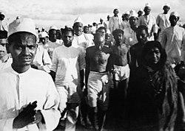

Slide 14
INDIGO
Louis Fischer

Slide 15
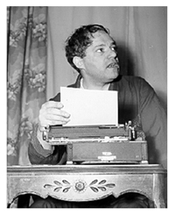
About Louis Fischer

Slide 16
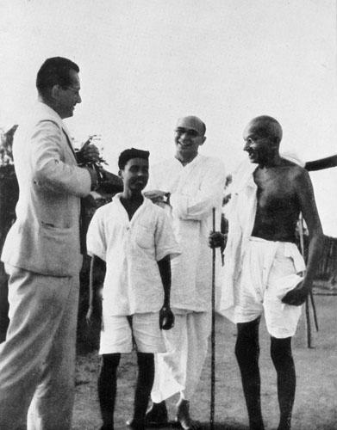
Louis Fischer (29 February 1896 – 15 January 1970) was an American journalist. Among his works were a contribution to the ex-communist treatise The God that Failed (1949), The Life of Mahatma Gandhi (1950), basis for the Academy Award-winning film Gandhi (1982), as well as a Life of Lenin, which won the 1965 National Book Award in History and Biography .

Slide 17
In Fischer’s book, the Western reader can see Gandhi’s development as a whole for the first time. This is important, because a key to the understanding of Gandhi is to know that he was a man with an extraordinary capacity for growth. While his central approach and the outlines of his techniques were developed early in his public career, they were constantly modified and enriched by experience and self-examination. Gandhi had all the flexibility possible to a man who is sure of his first principles.

Slide 18
🔹 Mahatma Gandhi
🔹 Rajkumar Shukla (Poor farmer)
🔹 Land Lords
🔹 Rajendra Prasad & Other Advocates
❇️ Main Characters In This Story

Slide 19
Indigo is a story which deals with patience, courage and determination of Mahatma Gandhi to fight for Champaran.

Slide 20
🔹 This chapter depecits how the Britishers forced the farmers to plant Indigo on their land.
🔹 It also shows how the farmers were forced into an ancient arrangement of share cropping.
🔹 The chapter deals with importance of self reliance and civil disobedience.
🔹 It shows how Gandhi Ji tried to educate them and make the farmers fearless to fight their own battle.
🔹 Raj Kumar Shukla- A poor sharecropper from Champaran wishing to meet Gandhiji.

Slide 21
🔹 Raj Kumar Shukla- an illiterate but resolute (determined) hence followed Gandhiji to Lucknow, Kanpur, Ahemdabad, Calcutta, Patna, Muzzafarpur & then Champaran.
🔹 Servants at Rajendra Prasad’s residence thought Gandhi to be an untouchable because of his simple living style, scanty clothes and company of Raj Kumar Shukla.
🔹 Decided to go to Muzzafarpur first to get detailed information about Champaran sharecropper.
🔹 Sent telegram to J B Kriplani and stayed in Prof. Malkani’s home a government servant.
🔹 Gandhiji went to the British Official Commissioner who asked him to leave Trihut, Gandhiji disobeyed, went to Motihari the capital of Champaran where multitude greeted him, continued his investigations.

Slide 22
🔹 Indians afraid to show sympathy to the supporters of home rule.
🔹 The news of Gandhi’s arrival spread- sharecroppers gathered in large number to meet vast their champion.
🔹 Gandhiji chided the Muzzafarpur lawyer for taking high fee.
🔹 Champaran district was divided into estate owned by English people, Indians only tenant farmers.
🔹 Landlords compelled tenants to plant 15% of their land with indigo and surrender their entire harvest as rent.
🔹 In the meantime Germany had developed synthetic indigo-British landlords freed the Indian farmers from the 15% arrangement but asked them to pay compensation.

Slide 23

Many signed, some resisted, engaged lawyers, landlords hired thugs.
🔹Gandhiji reached Champaran- visited the secretary of the British landlord association to get the facts but denied as he was an outsider.
🔹 Visited maltreated villagers, stopped by the police superintendent but disobeyed the order.
🔹 Motihari black with peasants’ spontaneous demonstrations, Gandhi released without bail Civil Disobedience triumphed.
🔹 Gandhiji agreed to 25% refund by the landowners, it symbolized the surrender of the prestige.
🔹 Gandhiji worked hard towards social economic reforms, elevated their distress aided by his wife, Mahadev Desai, Narhari Parikh.
🔹 Gandhiji taught a lesson of self-reliance by not seeking help of an English man Mr. Andrews.

Slide 24
Thank you

